Slide 1


Notifications Issued based on 43rd
GST COUNCIL MEETING

Slide 2

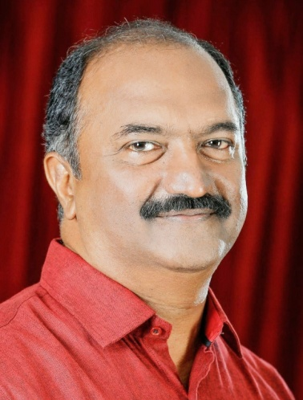
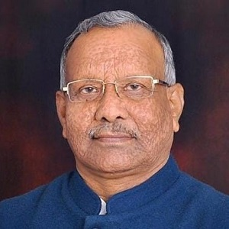
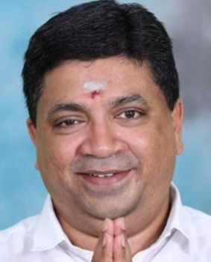
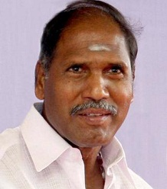
Five debutants in the 43rd GST Council meeting
Smti. Ajanta Neog
Shri K. N. Balagopal
Shri Tarkishore Prasad
Shri Palanivel Thiagarajan
Shri N. Rangaswamy
State | Old Member | New Member
Bihar | Shri Sushil Kumar Modi | Shri Tarkishore Prasad
Kerala | Shri T. M. Thomas Isaac | Shri K. N. Balagopal
Assam | Shri Himanta Biswa Sarma | Smti. Ajanta Neog
TamilNadu | Shri D. Jayakumar | Shri Palanivel Thiagarajan
Puducherry | Shri V. Narayanasamy | Shri N. Rangaswamy

Slide 3
Customs Exemptions for covid related items
20.04.2021 – Exemption from Basic Customs duty for Remdesivir (Notification 27/2021). Valid upto 31.10.2021.
24.04.2021 – Exemption from Basic Customs duty and Health Cess for Oxygen Concentrators, Medical Oxygen, Oxygen Cylinders, Oxygen filling systems, Oxygen Tanks, Covid Vaccine, etc. (Notification 28/2021). Valid upto 31.07.2021.
30.04.2021 – Inflammatory diagnostic kits (Notification 29/2021). Valid upto 31.10.2021.
01.05.2021 – Oxygen Concentrator imported for personal use – IGST reduced to 12 % (Notification 30/2021). Valid upto 30.06.2021.
03.05.2021 – All goods covered under Notifications 27 & 28/2021, IGST exempted, if imported free of cost, by approved agencies, for free distribution (Ad hoc exemption order 4/2021). Valid upto 30.06.2021. Extended upto 31.08.2021 by Ad hoc exemption order 5/2021)

Slide 4
Customs Exemptions for covid related items
31.05.2021 – Exemption from Basic Customs duty for Amphotericin (Notification 31/2021). Valid upto 31.07.2021.
31.05.2021 – All goods covered under Notifications 27 & 28/2021, IGST exempted, if donated to the Govt. or approved relief agencies for free distribution (import need not be free of cost) (Notification 32/2021). Valid upto 31.08.2021.

Slide 5
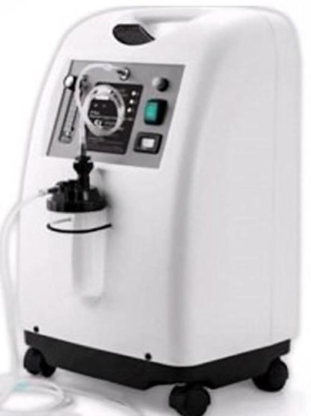
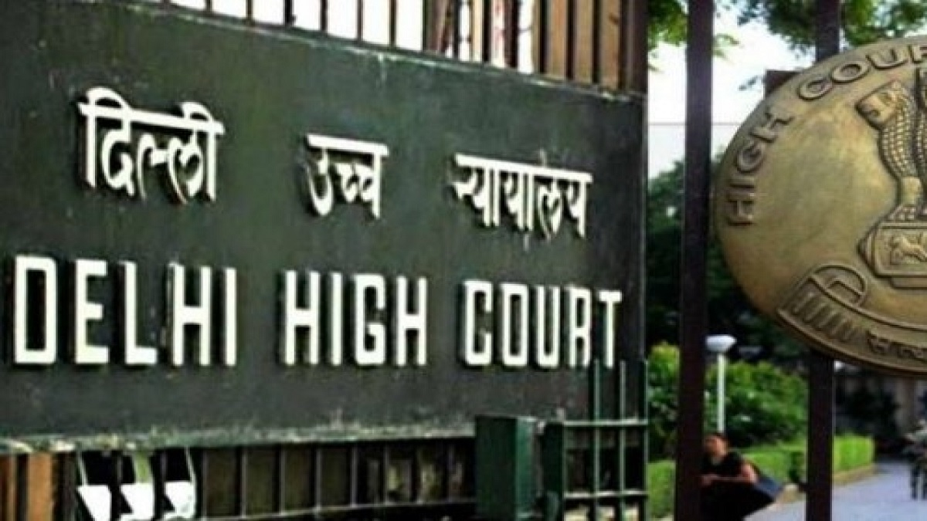
Gurucharan Singh Vs MOF

Slide 6
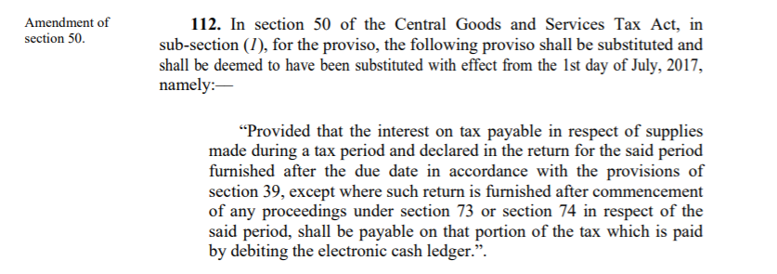
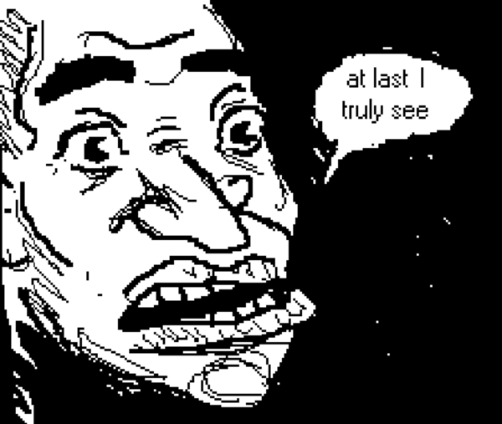
Notification No. 16/2021 – Central Tax dt. 01.06.2021
Interest liability only on the cash portion (net liability),retrospective amendment to Section 50 of the CGST Act notified w.e.f 01.06.2021.
Madras High Court decision in the following cases accepted
M/s Refex Industries Ltd - WP No.23360 of 2019
M/s Maansarovar Motors Pvt Ltd - W.P.No.4468 of 2020

Slide 7

Notification No. 17/2021 – Central Tax dt. 01.06.2021
Extended due date for filing of GSTR-1 for MAY 2021 is 26th June 2021.
This Photo by Unknown Author is licensed under CC BY-SA-NC

Slide 8
Notification No. 18/2021 – Central Tax dt. 01.06.2021
Relaxation in the interest liability on late filing of GSTR-3B returns for the tax periods March 2021, April 2021 and May 2021.
S.No. | Category of taxpayers | Facility available for the period of | Quantum of interest waiver / reduction
1 | Aggregate turnover of more than Rs. 5 crore in the preceding FY | March 2021, April 2021 and May 2021 | Interest payable @ 9 % p.a. (instead of 18%) for the first 15 days delay from due date and thereafter 18 % p.a.
2 | Aggregate turnover less than Rs. 5 crore in the preceding FY – who opted to file monthly returns/quarterly returns | March 2021 | No interest for first 15 days delay; 9 % interest for the next 45 days; and 18 % interest thereafter
 |  | April 2021 | No interest for first 15 days delay; 9 % interest for the next 30 days; and 18 % interest thereafter
 |  | May 2021 | No interest for first 15 days delay; 9 % interest for the next 15 days; and 18 % interest thereafter

Slide 9
S.No. | Category of taxpayers | Facility available for the period of | Quantum of interest waiver / reduction
3 | Composition taxpayers | Quarter ending March 2021 | No interest for first 15 days delay; 9 % interest for the next 45 days (as against 15 days prescribed earlier); and 18 % interest thereafter

Slide 10
Notification No. 19/2021 – Central Tax dt. 01.06.2021
Partial waiver from the late fee payable for the delay in filing GSTR 3 B returns for the tax periods March 2021 to May 2021
S.No. | Category of taxpayers | Tax period for which relief is given from Lat fee | Period beyond due date, for which late fee waived
1 | Aggregate turnover of more than Rs. 5 crore in the preceding FY | March 2021, April 2021 and May 2021 | For 15 days beyond the due date, no late fee.
2 | Aggregate turnover less than Rs. 5 crore in the preceding FY – who opted to file monthly returns | March 2021 | For 60 days beyond the due date, no late fee.
 |  | April 2021 | For 45 days beyond the due date, no late fee.
 |  | May 2021 | For 30 days beyond the due date, no late fee.
3 | Aggregate turnover of less than Rs. 5 crore in the preceding FY – who opted to file quarterly returns | Jan to Mar 2021 | For 60 days beyond the due date, no late fee.

Slide 11


Amnesty Scheme relating to GSTR-3B returns
If GSTR-3B is filed between 01.06.2021 to 31.08.2021 for the tax period July 2017 to April 2021, late fee reduced
a. Nil Returns - Rs. 500/- (Rs. 250/- CGST & SGST each) per return
b. Other Taxpayers - Rs 1000/- (Rs. 500/- CGST & SGST each) per return
I am yet to file
I have filed with huge late fee, where is my refund?

Slide 12
GSTR-3B Late Fee June 2021 onwards
S.No. | Class of Registered Persons | Maximum Amount of late fee
1 | Tax Payable “NIL” | Rs. 250/- CGST & SGST each
2 | Aggregate turnover upto 1.5 crs (preceding FY) | Rs. 1,000/- CGST and SGST each
3 | Aggregate turnover more than 1.5 crs and upto 5 crs. (preceding FY) | Rs. 2,500/- CGST and SGST each
4 | Aggregate turnover more than 5 crs (preceding FY) | Rs. 25 per day, subject to max of Rs. 5,000/- CGST and SGST each

Slide 13
Notification No. 20/2021 – Central Tax dt. 01.06.2021
GSTR-1 Late Fee June 2021 onwards
S.No. | Class of Registered Persons | Maximum Amount of late fee
1 | “NIL” outward supplies | Rs. 250/- CGST & SGST each
2 | Aggregate turnover upto 1.5 crs (preceding FY) | Rs. 1,000/- CGST and SGST each
3 | Aggregate turnover more than 1.5 crs and upto 5 crs. (preceding FY) | Rs. 2,500/- CGST and SGST each
4 | Aggregate turnover more than 5 crs (preceding FY) | Rs.25 per day subject to max of Rs. 5,000/- CGST and SGST each

Slide 14
Notification No. 21/2021 – Central Tax dt. 01.06.2021
GSTR-4 Late Fee FY 2021-2022 onwards
S.No. | Class of Registered Persons | Maximum Amount of late fee
1 | Tax Payable “NIL” | Rs. 250/- CGST & SGST each
2 | Other than NIL tax | Rs. 1,000/- CGST and SGST each
Notification No. 22/2021 – Central Tax dt. 01.06.2021
TDS return under GSTR-7 Late Fee June 2021 onwards maximum of Rs. 1,000/- CGST and SGST each

Slide 15
Notification No. 23/2021 – Central Tax dt. 01.06.2021
Government Departments and Local Authorities excluded from issuance of e-invoice.
Local Authority defined Section 2 clause (69) of CGST Act 2017
(69) “local authority” means––
(a) a “Panchayat” as defined in clause (d) of article 243 of the Constitution;
(b) a “Municipality” as defined in clause (e) of article 243P of the Constitution;
(c) a Municipal Committee, a Zilla Parishad, a District Board, and any other authority legally entitled to, or entrusted by the Central Government or any State Government with the control or management of a municipal or local fund;
(d) a Cantonment Board as defined in section 3 of the Cantonments Act, 2006;
(e) a Regional Council or a District Council constituted under the Sixth Schedule to the Constitution;
(f) a Development Board constituted under article 371[and article 371J]8 of the Constitution; or
(g) a Regional Council constituted under article 371A of the Constitution;

Slide 16
Notification No. 24/2021 – Central Tax dt. 01.06.2021
Where the time limit for issuing any notice, filing of appeal, reply, order or application or furnishing of any report, document, return, statement falls between 15.04.2021 to 29.06.2021 the same shall stand extended to 30.06.2021.
The above benefit of time extension would also be available to merchant exporter.
The above extension is not applicable in, registration, provisions related to casual taxable person and non-resident taxable person, lapsing of Composition Scheme on crossing the aggregate turnover, issue of tax invoice, filing of GSTR 1 & 3B return, levy of late fee, interest, power to arrest, liability of partners of firm to pay tax, penalty on bill trading transactions, detention, seizure and release of goods in transit, issue of e way bill.
If the time limit for completion of any action, by any authority relating to verification and approval of registration application, falls during the period from the 01.05.2021 to the 30.06.2021, it shall be extended up to 15.07.2021.

Slide 17
Notification No. 25/2021 – Central Tax dt. 01.06.2021
Due date for filing of GSTR-4 for the Financial Year 2020-2021 is extended to 31st July 2021.
Notification No. 26/2021 – Central Tax dt. 01.06.2021
Due date for furnishing ITC-04 for the tax period January 2021 to March 2021 is extended from 31st May to 30th June 2021

Slide 18
Notification No. 27/2021 – Central Tax dt. 01.06.2021
Assesee who furnish GST returns viz. GSTR-1 & 3B through DSC are allowed to furnish using EVC until 31st August 2021.
Rule 36(4) shall be applicable on cumulative basis for the tax periods April to June 2021 in June 2021 GSTR-3B returns.
Assessee using IFF to provide invoice details can now provide the invoice details for May 2021 until 28.06.2021.

Slide 19
Rate changes – Notification 1-3/2021 C.T.(R) Dt. 02.06.21
Diethylcarbamazine – 5 %.
MRO services for ships – 5 %.
In case of Joint Developments, in order to enable Landowner-Promoters to avail and utilise ITC of GST charged on them by the Promoters, they are permitted to pay GST at any time upto obtaining CC. Earlier they were liable to pay GST as and when they sell their share of apartments before completion, but the Promoter would pay GST for the Landowner apartments only at the time of obtaining CC.

Slide 20
THANK YOU
mail@swamyassociates.com
www.swamyassociates.com

